Slide 1

http://datasploit.info | @datasploit

Slide 2

Just another Pen-tester.
Security Consultant @ NotSoSecure
5+ Years of Experience
Worked as both Attacker, Defender.
Interests in Offensive Security, Defensive Security, Scripting, OSINT.
Free time ~ Travelling.
Speaker / Trainer / Presenter @ BlackHat, DefCon, NullCon, IETF.

Slide 3
What’s DataSploit?
Performs Automated OSINT (Reconnaissance) on Domain / Email / Username.
Fetches information from multiple online sources.
Works in passive mode, i.e. not a single packet is sent to the target.
Customized for Pen-testers / Product Security Guys / Cyber Investigators.

Slide 4









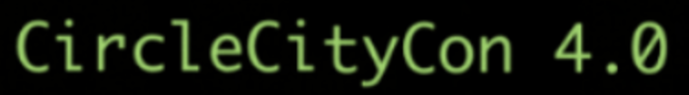



Coverage

Slide 5
Components
Domain Osint
Email Osint
IP Osint
Username Osint
WIP
Company Scoping
Phone Number OSINT
Active Modules

Slide 6
Sources
Domain:
WhoIS
DNS Records
PunkSpider
Wappalyzer
Github
Email Harvestor →→
Domain IP History
Pagelinks
Wikileaks
Subdomains
Links from Forums
Passive SSL Scan
ZoomEye
Shodan
Censys
Email:
Basic Email Checks
Work History
Social profiles
Location Information
Slides
Scribd Documents
Related Websites
HaveIBeenPwned
Enumerated Usernames →→
Username:
Git Details
Check username on various sites.
Profile Pics –Output saved in $username directory
Frequent Hashtags
Interaction on Twitter.

Slide 7
Documentation
http://www.datasploit.info
http://datasploit.readthedocs.io/en/latest/
https://upgoingstar.github.io/datasploit/

Slide 8
Setting it up..
Download from git (git clone or dowload)
git clone https://github.com/DataSploit/datasploit.git
pip install –r requirements.txt
Config.py holds API keys
domain_xyz.py – running stand alone scriptss.
domainOsint / emailOsint – automated OSINT

Slide 9
Install Using Docker… Why not?
https://hub.docker.com/r/appsecco/datasploit/
https://hub.docker.com/r/ftorn/datasploit/

Slide 10
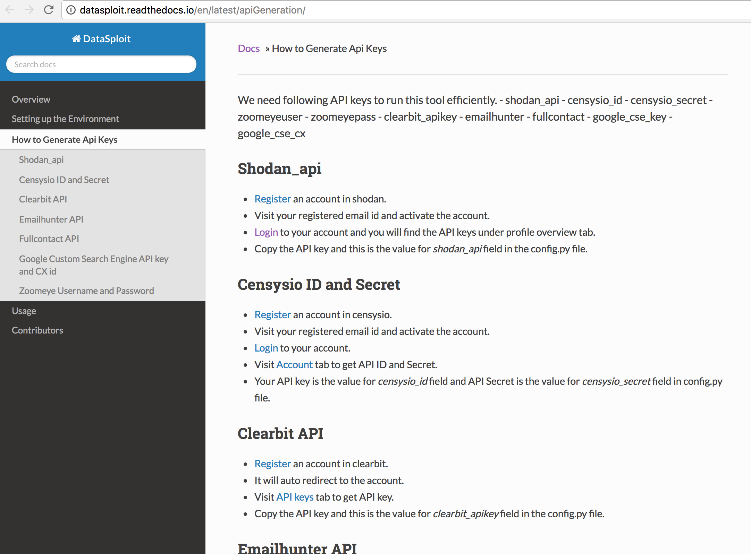
Documentation.

Slide 11
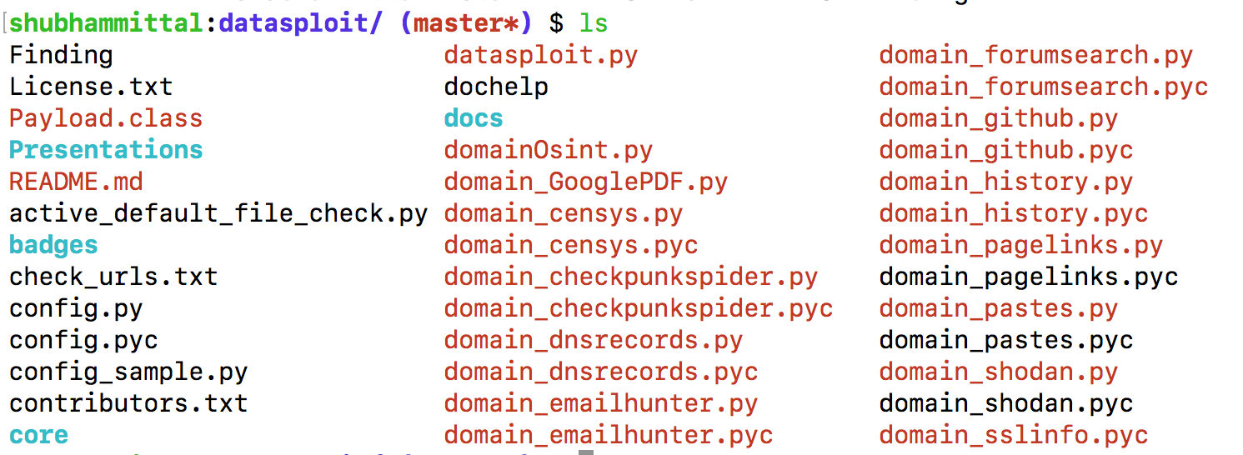
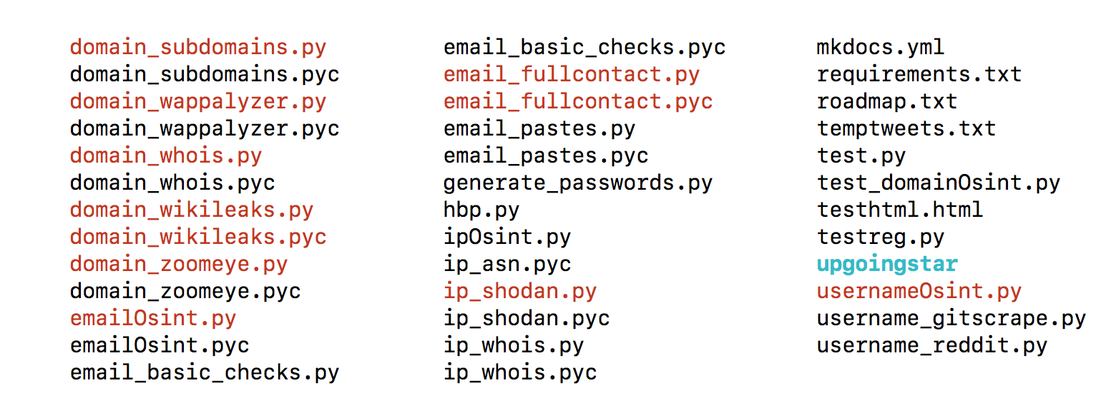
What’s in there?

Slide 12
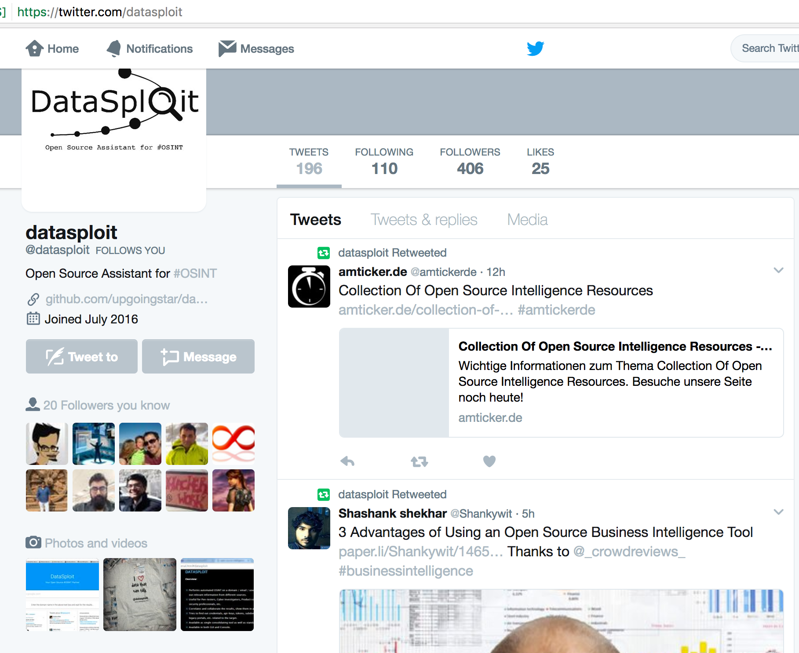
Twitter: @datasploit https://twitter.com/datasploit

Slide 13
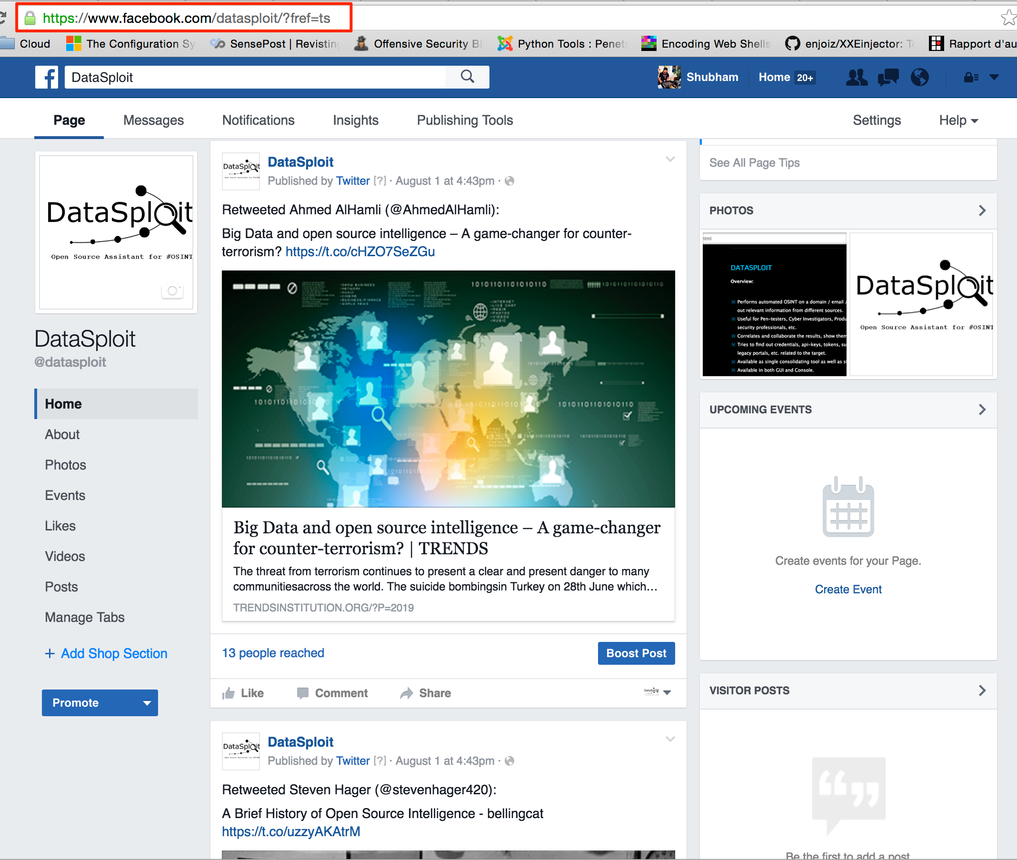
Facebook: /datasploit https://www.facebook.com/datasploit/

Slide 14
Roadmap
Allows to set up periodic scans and alerting for product security companies.
Intelligence on co-relation and identity verification.
Reports in CSV, JSON and HTML Format
Reverse Image Search and profile validation.
Works closely with various social network APIs.
Highlight credentials, api-keys, tokens, subdomains, domain history, legacy portals, etc. related to the target from more than 50 paste(s) websites.
IP Threat Intelligence
Active Scan modules.
Organization Scoping.
Integration with SE other tools.
Cloud related OSINT and active modules.
pip install datasploit (to be installed as both library as well as script)

Slide 15
Important Stuff.
Web UI is no more supported by us.
Feel free to explore previous commits for GUI Components.

Slide 16
How to Contribute
Test the tool (we are not full time devs, so you know ;))
Write a module. Or Suggest a module. (we love feedbacks).
You can raise an issue with ‘enhancement / new feature’ label, drop an email or simply catch up.
Use / Promote / Write about the tool.
Write OSINT blogs / tool walkthrough(s) / etc.
Report issues at https://github.com/upgoingstar/datasploit/issues

Slide 17
Core Contributors.
Shubham Mittal (@upgoingstar)
Nutan Kumar Panda (@nutankumarpanda)
Sudhanshu (@sudhanshu_c)
Kunal (@KunalAggarwal92)
Kudos to
@anantshri for mentoring.
@chandrapal for feedbacks, suggestions and other help around issues.

Slide 19
Thanks. g0t questions?
https://github.com/DataSploit/datasploit
Follow @datasploit for OSINT news and latest updates.
Tweet / DM to @datasploit
upgoingstaar@gmail.com

